Slide 1
The implications of Urban Air Mobility: Case study in South Korea
Based on Methodology review
STP601 Yunji Woo

Slide 2
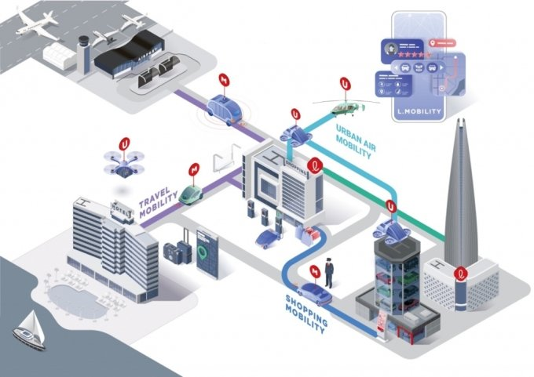
Urban Air Mobility(UAM)
Policy Issues on UAM
Vehicle configurations
Top-Level Aircraft Requirements
Range, Flight time, Passengers
Propulsion system
Vertiport installation
Air Traffic management (CNSi)
Seamless multi-modal transportation
Technology
Infrastructure
Societal considerations
Regulation
Noise, Visual pollution, Privacy
Safety
Market value estimation
Verification of Pilot and Manufacturer
AI based system automation
Unmanned system
Concept of UAM, 롯데정보통신

Slide 3
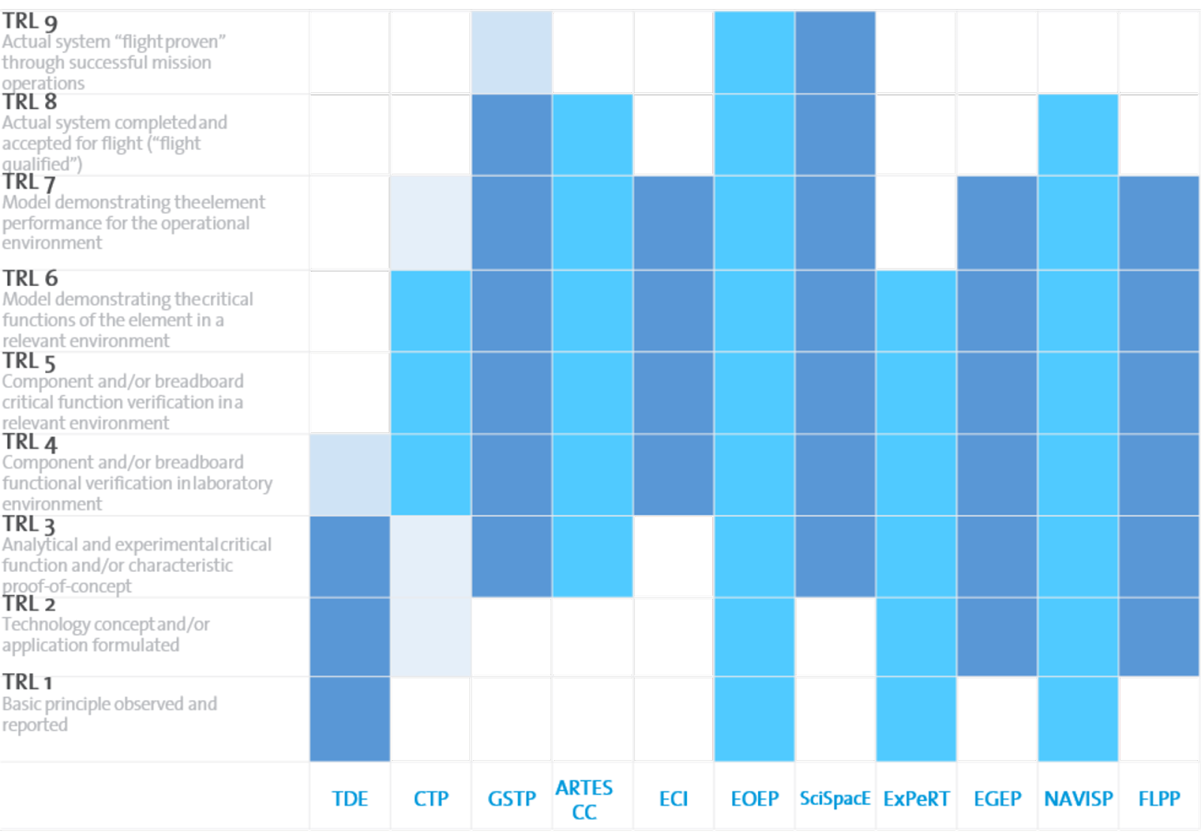
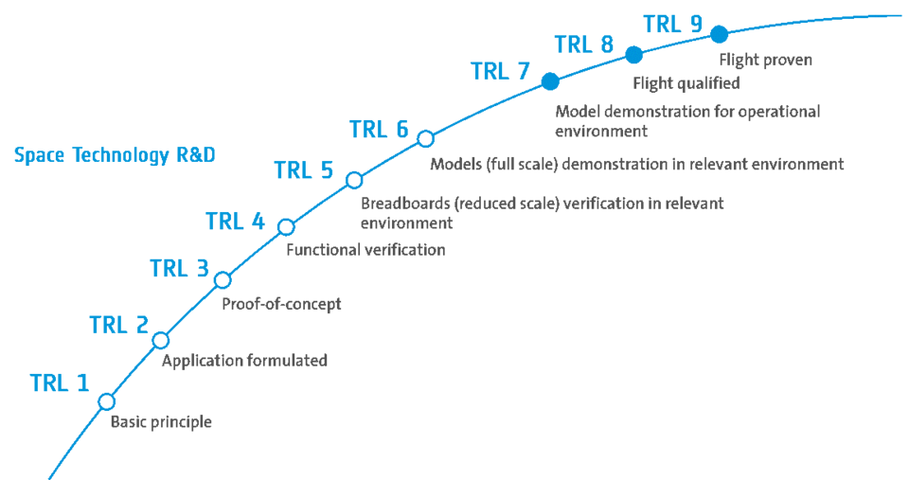
Technology readiness level analysis
Technology
Infrastructure
Technology roadmapping – A planning framework for evolution and revolution
Technology readiness Levels (TRL) are used to assess the maturity of a new technology towards full economic operation.
TRLs are often used by governments and other funding bodies to define eligibility criteria.
EASA https://esa.int/Enabling_Support/Space_Engineering_Technology/Shaping_the_Future/Technology_Readiness_Levels_TRL

Slide 4
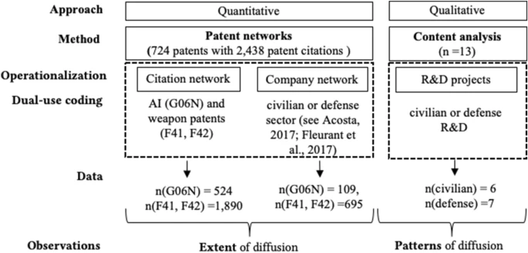
Network Research
Technology
Infrastructure
Network research
Technology & Knowledge diffusion
Policy isomorphism

Slide 5
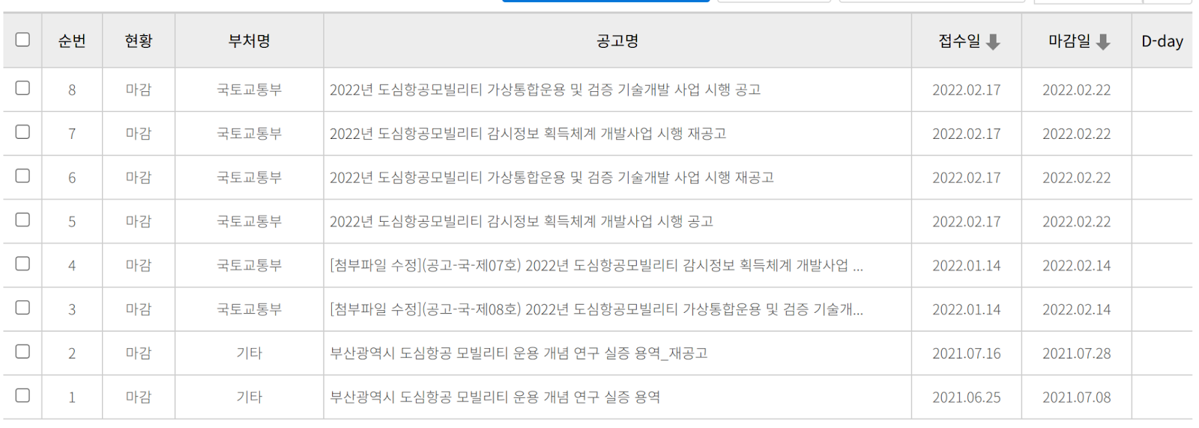
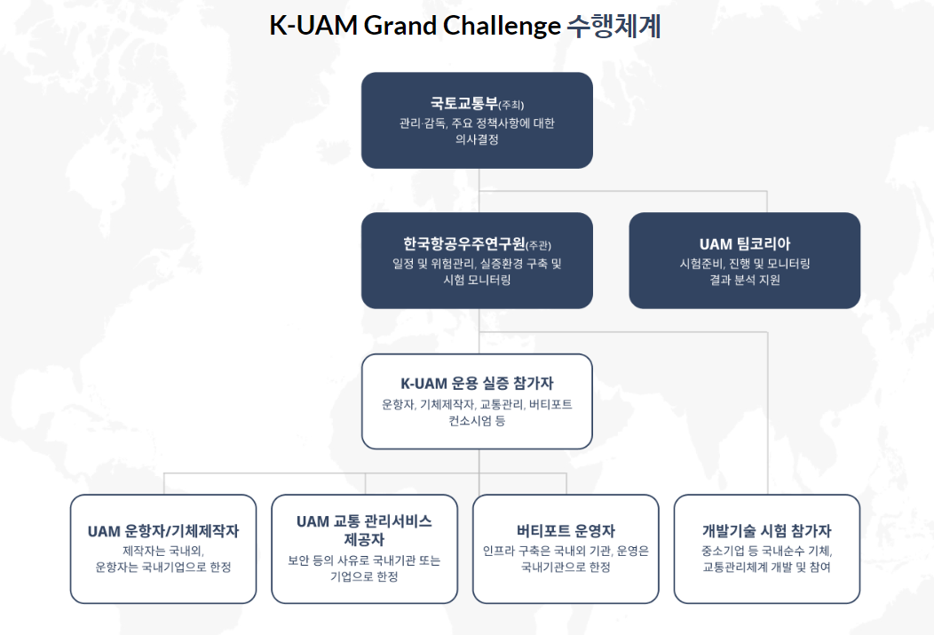
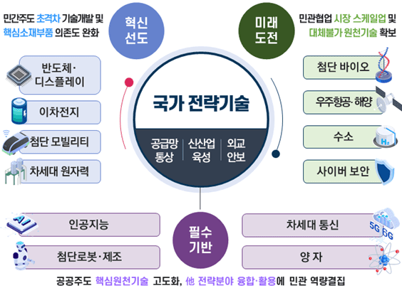
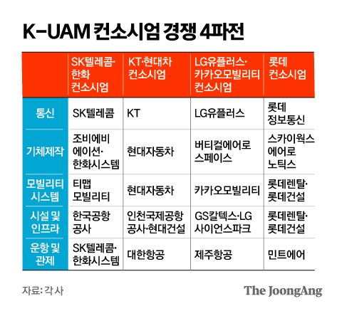
Network research
Technology
Infrastructure
Network research
R&D project funding & Consortium
K-UAM Grand challenge http://kuam-gc.kr/

Slide 6
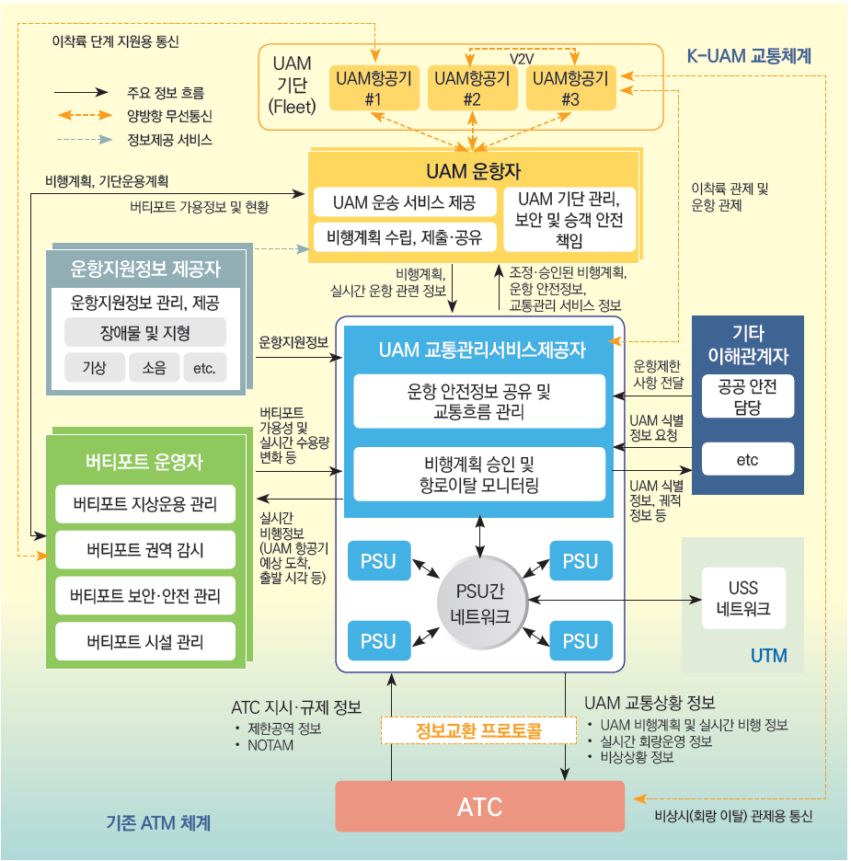
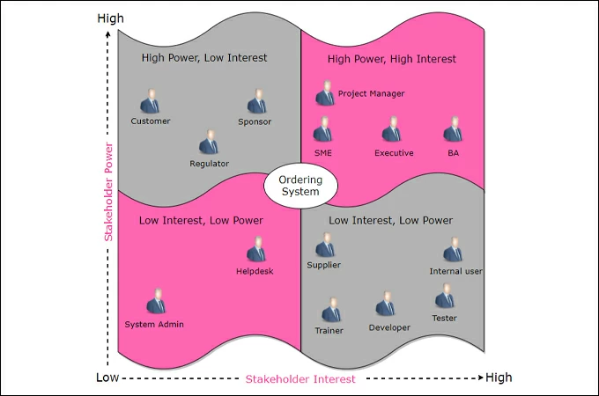
Stakeholder Analysis
Infrastructure
Regulation
Stakeholder analysis
Who are associated?

Slide 7
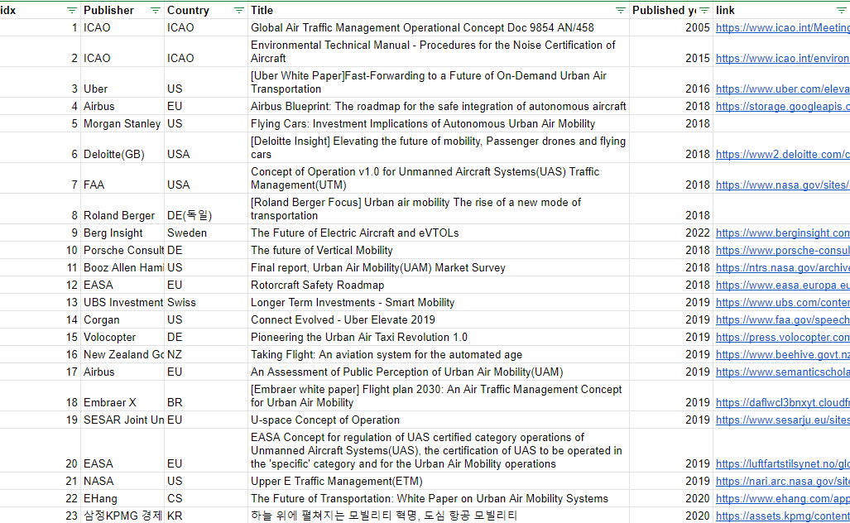
Data collection - Report
Societal considerations
Regulation
Government & Company report review

Slide 8
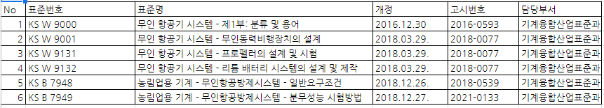
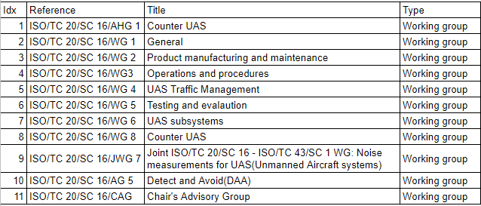
Data collection – standardization & legislations
Societal considerations
Regulation
International & Domestic standardization
Legislations related to regional concept of operations
KS Standard relates to UAM & Drones
ISO Standard relates to UAM & Drones & UAVs

